Slide 1
Overview of Security Concepts

Slide 2
Outline
What is Security?
Core Goals of Security (CIA Triad)
Security concepts: Threat, Vulnerability, Risk and Controls

Slide 3
What is Security?

Slide 4
What is Security?
Security = protection from harm
3 main categories of harm:
Theft of information (e.g., corporate secrets, personal information, military intelligence)
Alteration of information (e.g., break in and deface a website, alter DB records to cover-up fraud)
Denial of Service (DoS) – system busy responding to attackers and no longer available to provide serve to legitime users
Notes:
Protection from harms from malicious entities or intruders
Oxford Dictionary Definition: The state of being free from danger or threat
Computer Security = Protection of computer systems from harm on the hardware, the software and the data
Protection from harm
3 main categories of harm:
- Theft of information (e.g., corporate secrects, personal information, ideas/ip, militeray intelligence) .. prevent stealing sensitive information that can be used for identity theft
- Alteration of information (e.g., break in and deface a website, alter db to cover-up fraud).
(alter data, system configurations)
- Denial of Service (Dos) - busy responding to attackers and no longer available to provide servive to elgitime users
Confidential data remain confidential
Data are not changed by unauthorized users or in malicious ways
Systems remain operational, reachable, functional and available for legitimate users
(distruct the operation of the attacked entity)

Slide 5
Real-World Security
Protecting valuable things
Physical stuff (money, jewelery, cars, phone, etc.)
People
Access to somewhere (parking, house, office?)
Generally, we think of an item as secure if no one can take it, harm it, or use it without our permission.

Slide 6
Core Goals of Security (CIA Triad)

Slide 7
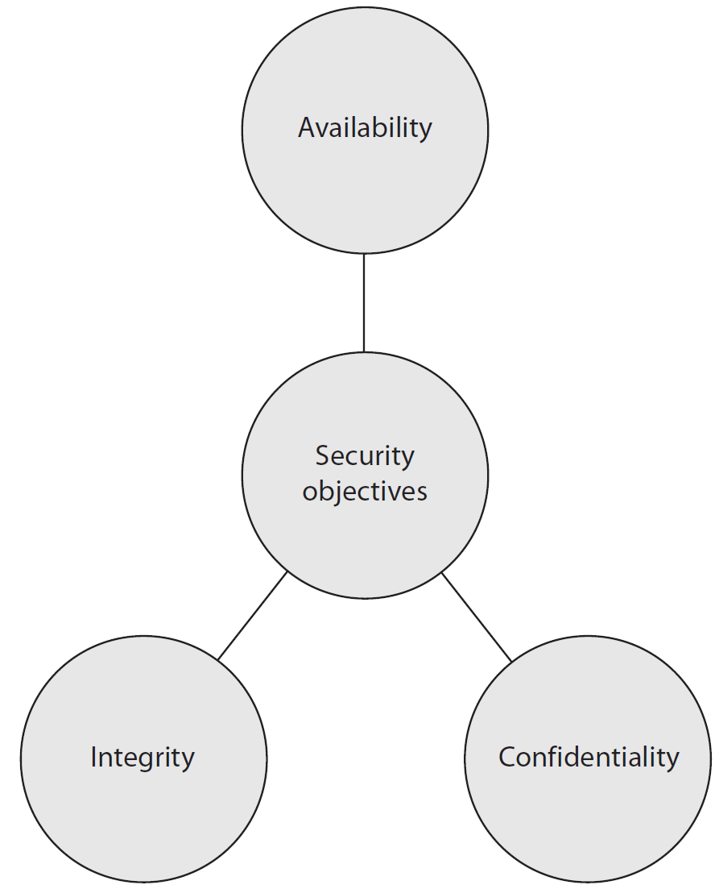
Core Goals of Computer Security
Also known as CIA Triad
Notes:
These three concepts form what is often referred to as the CIA triad . The
three concepts embody the fundamental security objectives for both data and for
information and computing services. For example, the NIST Standards for Security
Categorization of Federal Information and Information Systems (FIPS 199) lists
confidentiality, integrity, and availability as the three security objectives for information
and for information systems. FIPS 199 provides a useful characterization
of these three objectives in terms of requirements and the definition of a loss of
security in each category.
• Confidentiality: Preserving authorized restrictions on information access
and disclosure, including means for protecting personal privacy and proprietary
information. A loss of confidentiality is the unauthorized disclosure of
information.
• Integrity: Guarding against improper information modification or destruction,
including ensuring information nonrepudiation and authenticity. A loss of
integrity is the unauthorized modification or destruction of information.
• Availability: Ensuring timely and reliable access to and use of information.
A loss of availability is the disruption of access to or use of information or an
information system.

Slide 8
Three Security Properties
Confidentiality
Prevent unauthorized reading of confidential data
Integrity
Prevent unauthorized/malicious modification of data
Availability
Ensure data is available to authorized people
Systems remain operational, reachable, functional and available for legitimate users
Notes:
Confidential data remain confidential
Data are not changed by unauthorized users or in malicious ways
Systems remain operational, reachable, functional and available for legitimate users
(disrupt the operation of the attacked entity)

Slide 9
Example Attack Scenario Compromising Availability
Denial of Service: Possible to overwhelm and Online Service making it unavailable

Slide 10
How to achieve security goals?
Understand the adversary
what are the resources available?
what is the goal of the attack?
Understand the modes of attack.
in what ways can the attack be launched?
what are the vulnerabilities?
Understand the security/usability tradeoff
Notes:
Add a tool does not necessarily make a system more secure.

Slide 11


About the adversary
The adversary can be either active or passive.
Active:
He takes an active part in the scenario
He corrupts a transmitted messages
He prevents an ongoing communication
He injects a virus into a system
Passive:
He is silent and stealthy
He eavesdrops the radio communications
He logs the messages transmitted in the local network

Slide 12
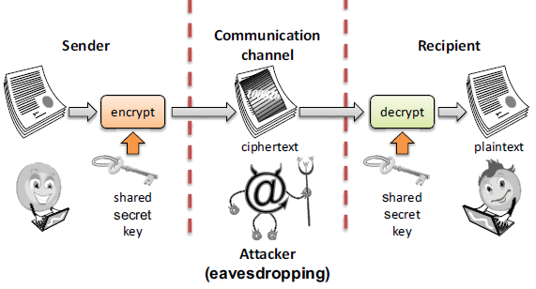
Tools for Ensuring Confidentiality(1/2)
Encryption: encrypt data using an encryption key
Notes:
The key may, in some cases, be the same as the encryption key.

Slide 13
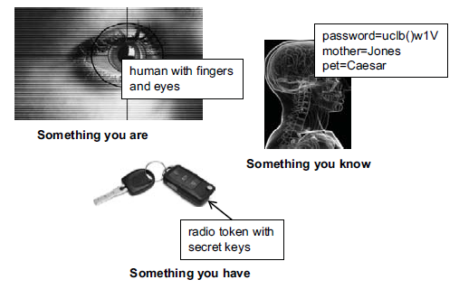
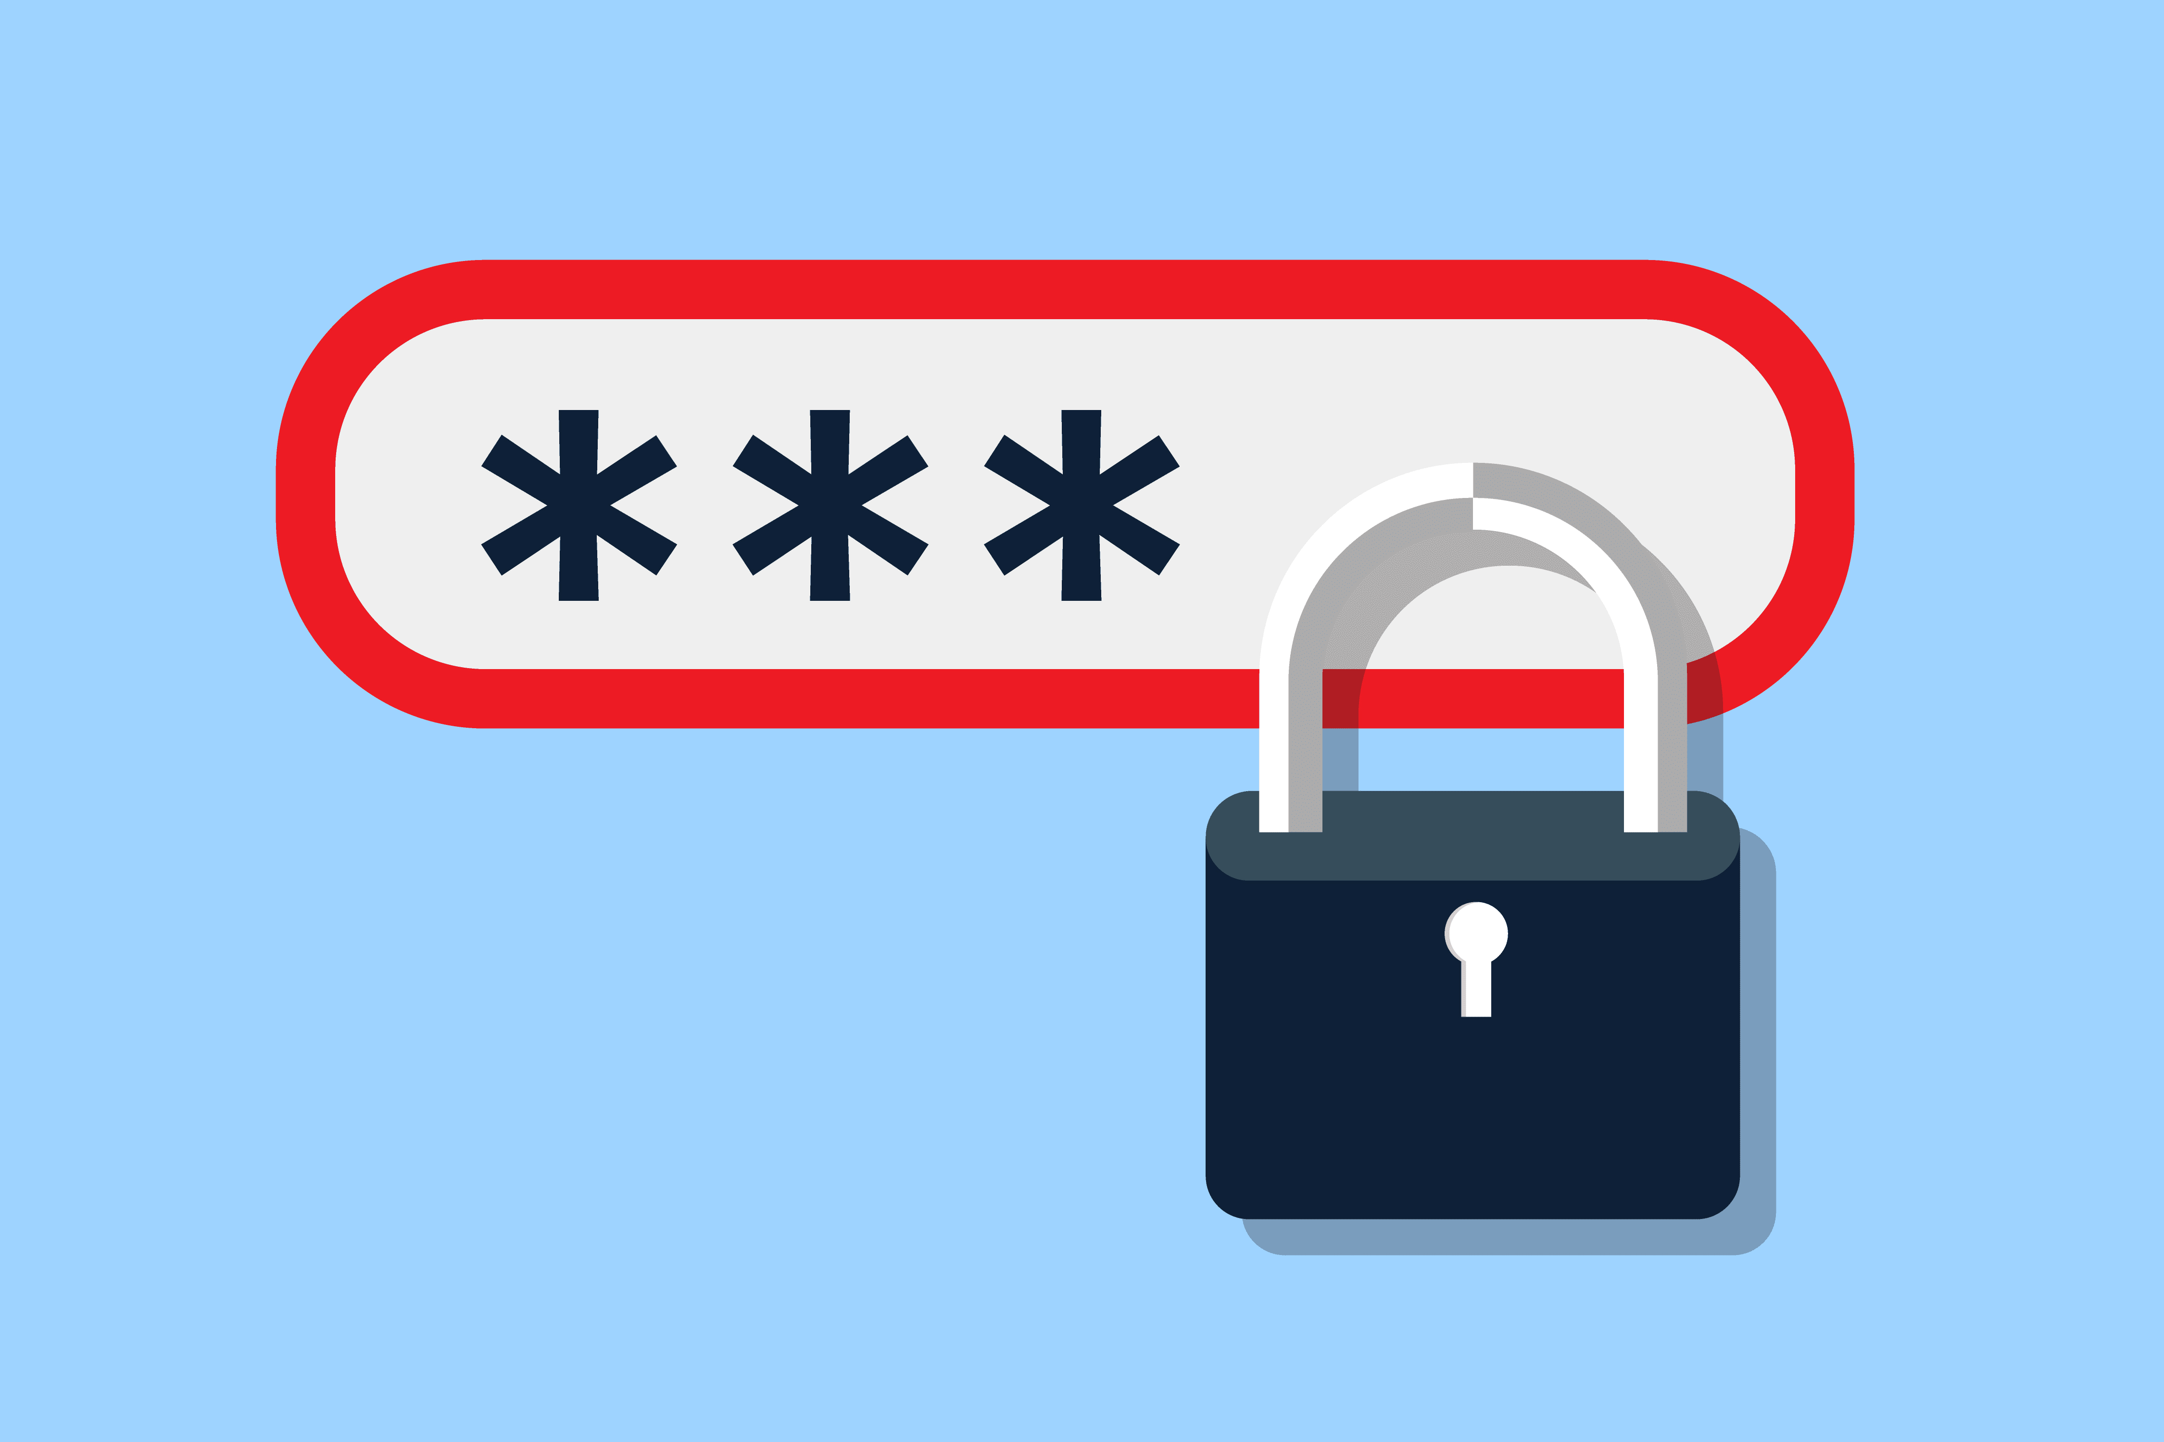
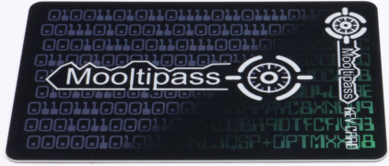
Tools for confidentiality (2/3)
Authentication: determination of the identity or role that someone has.
Fingerprint, password, smart card / radio key
Smartcard with secret key

Slide 14
Tools for integrity
Prevention Mechanisms
Authentication
Access control
Message signing: cryptographic technique to detect whether bits have been modified
Detection Mechanisms
Intrusion detection and prevention: try and understand normal behavior and detect anomalous
Monitors the characteristics of a single host for suspicious activity
Monitors network traffic and analyzes network, transport, and application protocols to identify suspicious activity
Deep packet inspection: look at packet contents (e.g., check character strings in packet against database of known virus, attack strings)
Notes:
Physical barriers : secure building
The construction of building incorporating copper mesh (called Faraday cages) so that electromagnetic cannot enter or exit the enclosure.
Data correcting codes: the ability to restore the original data if a transient error took place.
Message authentication code: cryptographic technique to detect whether bits have been modified

Slide 15
Tools for availability
Redundancies
e.g., backup, multiple mail/DNS/DHCP servers, multiple network paths to ISP
Firewall
Isolates organization’s internal net from larger Internet, allowing some packets to pass, blocking others
Intrusion prevention
Notes:
Physical barriers : secure building
The construction of building incorporating copper mesh (called Faraday cages) so that electromagnetic cannot enter or exit the enclosure.
Was a major goal of Internet design (to be nuclear blast proof)

Slide 16
Summary of Tools for achieving CIA
Confidentiality
Encryption
Access Control
Authorization
Integrity
Prevention Mechanisms
Detection Mechanisms
Availability
Redundancy
Intrusion Detection/Prevention
Notes:
Economy of mechanism: the design of security measures embodied in both hardware and software should be as simple and small as possible.
Fail-safe defaults: access decisions should be based on permission rather than exclusion.
Complete mediation: every access must be checked against the access control mechanism.
Open Design: the design of a security mechanism should be open rather than secret.
Separation of privilege: a practice in which multiple privilege attributes are required to achieve access to a restricted resource.
Least Privilege: every process and every user of the system should operate using the least set of privileges necessary to perform the task.
Least common mechanism: the design should minimize the functions shared by different users, providing mutual security.
Psychological acceptability: the security mechanisms should not interfere unduly with the work of users, while at the same time meeting the needs of those who authorize access.
Isolation: a principle that applies in three contexts. (1) public access systems should be isolated from critical resources (data, processes, etc.) to prevent disclosure or tampering. (2) the processes and files of individual users should be isolated from one another except where it is explicitly desired. (3) security mechanisms should be isolated in the sense of preventing access to those mechanisms.
Encapsulation: a specific form of isolation based on object-oriented functionality.
Modularity: refers both to the development of security functions as separate, protected modules and to the use of a modular architecture for mechanism design and implementation.
Layering: the use of multiple, overlapping protection approaches addressing the people, technology, and operational aspects of information systems.
Least Astonishment: means that a program or user interface should always respond in the way that is least likely to astonish the user.

Slide 17
Exercise
Classify each of the following as a violation of confidentiality, of integrity, of availability, or of some combination
Ali logs into Fatima’s Facebook, posts a photo
Steve sees network traffic of Apple’s earning projections and sells Apple stock
Jenny forges a request to Banner to change her Computer Security homework grade
Ali Taleh causes the power system to fail, taking the submission server offline

Slide 18
Security concepts: Threat, Vulnerability, Risk and Controls

Slide 19
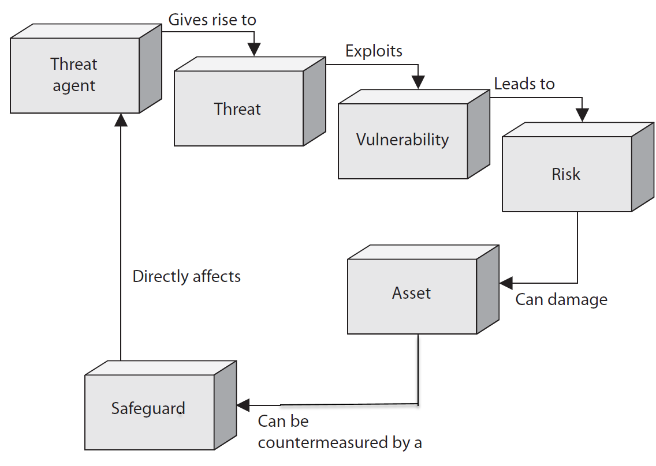
The relationships among the different security concepts
Notes:
Threat Model
We’ll spend time trying to understand what an attacker can and cannot do, their goals, capabilities, etc.
This will help focus our attention to defending the system
Virus
Propagates by infecting other programs
Usually inserted into host code (not a standalone program)
Worms
Propagates automatically by copying itself to target systems
A standalone program
What property do we want to ensure against what adversary?
Who is the adversary?
What is his goal?
What are his resources?
e.g. Computational, Physical, Monetary…
What is his motive?
What attacks are out of scope?

Slide 20
Vulnerability
Asset: entity you want to protect, e.g., your data.
A vulnerability is a weakness in a system that allows a threat to be realized, compromising CIA.
e.g., unpatched applications or OS, an unrestricted wireless access point
Identifying vulnerabilities:
How is a system potentially affected by a threat?
What weaknesses are present in a system that enable a threat to materialize and compromise CIA?
Notes:
Threats = possible dangers that could compromise the Confidentiality, Intergrity, or Availablity of a computer system or service
(Can be malicious or accidental. May be external or internal)
Vulne:
A vulnerability is a weakness in a system that allows a threat source to compromise its security.
Weakness in a system that permit a threat to be realized, compromising CIA
(flaw that can be exploited by an attacker with the correct tools, or by the correct situation)
Identifying:
- How is a system potentially affected by a threat?
- What weaknesses are present in a system that enable a theat to materialize into dysfunction?
Controls:
- Safeguards implemented to close vulnerabilities and mitigate threats in order to protect CIA of the system
- Controls can be physical (locking the door denies access), procedural (2 employees has to be present) or technical in nature (system polcies such as require data to be encrypted).
Identiyfing controls:
- How can vulnerabilities be closed and/or threats mitigated?
- What safeguards (protective measures) can be put in place to make a system less vulnerable to a threat?
Controls should be proportional to the risk
Idemtifying threats:
- How can a system be compromised?
- What are the ways that the Confidentiality, Intergrity, or Availablity of the system can be reduced?
A few definitions:
• Asset: entity you want to protect, e.g., your data.
• Vulnerability: weakness or gap in the system.
• Threat: Anything that can exploit a vulnerability.
An exposure is an instance of being exposed to losses. A vulnerability exposes an organization to possible damages.
Risk = probability + consequences
Attack: attempt to breach system security (DDoS)
Threat: a scenario that can harm a system (System unavailable)
Vulnerability: the “hole” that allows an attack to succeed (TCP)
A vulnerability is a weakness in a system that allows a threat source to compromise its security. It can be a software, hardware, procedural, or human weakness that can be exploited. A vulnerability may be a service running on a server, unpatched applications or operating systems, an unrestricted wireless access point, an open port on a firewall, lax physical security that allows anyone to enter a server room, or unenforced password management on servers and workstations.
A threat is any potential danger that is associated with the exploitation of a vulnerability. If the threat is that someone will identify a specific vulnerability and use it against the company or individual, then the entity that takes advantage of a vulnerability in port on the firewall, a process accessing data in a way that violates the security policy, or an employee circumventing controls in order to copy files to a medium that could expose confidential information.
A risk is the likelihood of a threat source exploiting a vulnerability and the corresponding business impact. If a firewall has several ports open, there is a higher likelihood that an intruder will use one to access the network in an unauthorized method. If users are not educated on processes and procedures, there is a higher likelihood that an employee will make an unintentional mistake that may destroy data. If an intrusion detection system (IDS) is not implemented on a network, there is a higher likelihood an attack will go unnoticed until it is too late. Risk ties the vulnerability, threat, and likelihood of exploitation to the resulting business impact.
An exposure is an instance of being exposed to losses. A vulnerability exposes an organization to possible damages. If password management is lax and password rules are not enforced, the company is exposed to the possibility of having users’ passwords compromised and used in an unauthorized manner. If a company does not have its wiring inspected and does not put proactive fire prevention steps into place, it exposes itself to potentially devastating fires.
A control, or countermeasure, is put into place to mitigate (reduce) the potential risk. A countermeasure may be a software configuration, a hardware device, or a procedure that eliminates a vulnerability or that reduces the likelihood a threat agent will be able to exploit a vulnerability. Examples of countermeasures include strong password management, firewalls, a security guard, access control mechanisms, encryption, and security-awareness training.s referred to as a threat agent. A threat agent could be an intruder accessing the network through a

Slide 21
Threat
A threat anything that can exploit a vulnerability.
Possible dangers that could compromise the Confidentiality, Integrity, or Availability of a computer system or service
Can be malicious or accidental. May be external or internal
Identifying:
How can a system be compromised?
What are the ways that the Confidentiality, Integrity, or Availability of the system can be reduced?
Notes:
Threats = possible dangers that could compromise the Confidentiality, Intergrity, or Availablity of a computer system or service
(Can be malicious or accidental. May be external or internal)
Idemtifying threats:
- How can a system be compromised?
- What are the ways that the Confidentiality, Intergrity, or Availablity of the system can be reduced?
Vulne:
Waekness in a system that permit a threat to be realized, compromising CIA
(flaw that can be exploited by an attacker with the correct tools, or by the correct situation)
Identifying:
- How is a system potentially affected by a threat?
- What weaknesses are present in a system that enable a theat to materialize into dysfunction?
Controls:
- Safeguards implemented to close vulnerabilities and mitigate threats in order to protect CIA of the system
- Controls can be physical (locking the door denies access), procedural (2 employees has to be present) or technical in nature (system polcies such as require data to be encrypted).
Identiyfing controls:
- How can vulnerabilities be closed and/or threats mitigated?
- What safeguards (protective measures) can be put in place to make a system less vulnerable to a threat?
Controls should be proportional to the risk
A few definitions:
• Asset: entity you want to protect, e.g., your data.
• Vulnerability: weakness or gap in the system.
• Threat: Anything that can exploit a vulnerability.
An exposure is an instance of being exposed to losses. A vulnerability exposes an organization to possible damages.
Risk = probability + consequences
Attack: attempt to breach system security (DDoS)
Threat: a scenario that can harm a system (System unavailable)
Vulnerability: the “hole” that allows an attack to succeed (TCP)
A vulnerability is a weakness in a system that allows a threat source to compromise its security. It can be a software, hardware, procedural, or human weakness that can be exploited. A vulnerability may be a service running on a server, unpatched applications or operating systems, an unrestricted wireless access point, an open port on a firewall, lax physical security that allows anyone to enter a server room, or unenforced password management on servers and workstations.
A threat is any potential danger that is associated with the exploitation of a vulnerability. If the threat is that someone will identify a specific vulnerability and use it against the company or individual, then the entity that takes advantage of a vulnerability in port on the firewall, a process accessing data in a way that violates the security policy, or an employee circumventing controls in order to copy files to a medium that could expose confidential information.
A risk is the likelihood of a threat source exploiting a vulnerability and the corresponding business impact. If a firewall has several ports open, there is a higher likelihood that an intruder will use one to access the network in an unauthorized method. If users are not educated on processes and procedures, there is a higher likelihood that an employee will make an unintentional mistake that may destroy data. If an intrusion detection system (IDS) is not implemented on a network, there is a higher likelihood an attack will go unnoticed until it is too late. Risk ties the vulnerability, threat, and likelihood of exploitation to the resulting business impact.
An exposure is an instance of being exposed to losses. A vulnerability exposes an organization to possible damages. If password management is lax and password rules are not enforced, the company is exposed to the possibility of having users’ passwords compromised and used in an unauthorized manner. If a company does not have its wiring inspected and does not put proactive fire prevention steps into place, it exposes itself to potentially devastating fires.
A control, or countermeasure, is put into place to mitigate (reduce) the potential risk. A countermeasure may be a software configuration, a hardware device, or a procedure that eliminates a vulnerability or that reduces the likelihood a threat agent will be able to exploit a vulnerability. Examples of countermeasures include strong password management, firewalls, a security guard, access control mechanisms, encryption, and security-awareness training.s referred to as a threat agent. A threat agent could be an intruder accessing the network through a

Slide 22
Control
A control, countermeasure or safeguard, that can be implemented to close vulnerabilities and mitigate (reduce) the potential risk in order to protect CIA of the system
e.g., strong password management, firewalls, Intrusion Detection System, access control mechanisms, encryption, and security-awareness training
Identifying controls:
How can vulnerabilities be closed and/or threats mitigated?
What safeguards (protective measures) can be put in place to make a system less vulnerable to a threat?
Controls should be proportional to the risk
Notes:
Threats = possible dangers that could compromise the Confidentiality, Intergrity, or Availablity of a computer system or service
(Can be malicious or accidental. May be external or internal)
Vulne:
Waekness in a system that permit a threat to be realized, compromising CIA
(flaw that can be exploited by an attacker with the correct tools, or by the correct situation)
Identifying:
- How is a system potentially affected by a threat?
- What weaknesses are present in a system that enable a theat to materialize into dysfunction?
Controls:
- Safeguards implemented to close vulnerabilities and mitigate threats in order to protect CIA of the system
- Controls can be physical (locking the door denies access), procedural (2 employees has to be present) or technical in nature (system polices such as require data to be encrypted).
is put into place to mitigate (reduce) the potential risk
Identifying controls:
- How can vulnerabilities be closed and/or threats mitigated?
- What safeguards (protective measures) can be put in place to make a system less vulnerable to a threat?
Controls should be proportional to the risk
Idemtifying threats:
- How can a system be compromised?
- What are the ways that the Confidentiality, Intergrity, or Availablity of the system can be reduced?
A few definitions:
• Asset: entity you want to protect, e.g., your data.
• Vulnerability: weakness or gap in the system.
• Threat: Anything that can exploit a vulnerability.
An exposure is an instance of being exposed to losses. A vulnerability exposes an organization to possible damages.
Risk = probability + consequences
Attack: attempt to breach system security (DDoS)
Threat: a scenario that can harm a system (System unavailable)
Vulnerability: the “hole” that allows an attack to succeed (TCP)
A vulnerability is a weakness in a system that allows a threat source to compromise its security. It can be a software, hardware, procedural, or human weakness that can be exploited. A vulnerability may be a service running on a server, unpatched applications or operating systems, an unrestricted wireless access point, an open port on a firewall, lax physical security that allows anyone to enter a server room, or unenforced password management on servers and workstations.
A threat is any potential danger that is associated with the exploitation of a vulnerability. If the threat is that someone will identify a specific vulnerability and use it against the company or individual, then the entity that takes advantage of a vulnerability in port on the firewall, a process accessing data in a way that violates the security policy, or an employee circumventing controls in order to copy files to a medium that could expose confidential information.
A risk is the likelihood of a threat source exploiting a vulnerability and the corresponding business impact. If a firewall has several ports open, there is a higher likelihood that an intruder will use one to access the network in an unauthorized method. If users are not educated on processes and procedures, there is a higher likelihood that an employee will make an unintentional mistake that may destroy data. If an intrusion detection system (IDS) is not implemented on a network, there is a higher likelihood an attack will go unnoticed until it is too late. Risk ties the vulnerability, threat, and likelihood of exploitation to the resulting business impact.
An exposure is an instance of being exposed to losses. A vulnerability exposes an organization to possible damages. If password management is lax and password rules are not enforced, the company is exposed to the possibility of having users’ passwords compromised and used in an unauthorized manner. If a company does not have its wiring inspected and does not put proactive fire prevention steps into place, it exposes itself to potentially devastating fires.
A control, or countermeasure, is put into place to mitigate (reduce) the potential risk. A countermeasure may be a software configuration, a hardware device, or a procedure that eliminates a vulnerability or that reduces the likelihood a threat agent will be able to exploit a vulnerability. Examples of countermeasures include strong password management, firewalls, a security guard, access control mechanisms, encryption, and security-awareness training.s referred to as a threat agent. A threat agent could be an intruder accessing the network through a

Slide 23
Summing Up
Security = protection from harm
Secure computer system adheres to the principles of the CIA Triad:
Confidentiality
Integrity
Availability
Fundamental trade-offs exist between security and functionality, as well as between CIA Triad principles
Notes:
Be conservative: evaluate security under the best conditions for the adversary
A system is as secure as the weakest link.
It is best to plan for unknown attacks.
- Security = protection from harm
- Secure information systems adhere to the principles of the CIA Triad: C, I and A
- Fundamental trade-offs exist between security and functionality, as well as between CIA Triad principles
https://www.youtube.com/watch?v=vJeSxJesyw4&index=28&list=PLAHuATW6LHGmuuESAdlu-xPsmNhif0__s
They affect people and organizations
A system is as secure as its weakest component
Partly why security is so hard: attacker just needs to find the weakest link

